Slide 1

Becoming a Dynamics CRM/365 Developer
DYNAMICS 365

Slide 2

Mitch Milam
Dynamics CRM Architect
mitch@xrmcoaches.com
@mitchmilam
http://tinyurl.com/MitchMilamLinkedIn

Slide 3
Future Events
Webinar: Dynamics 365: All about notes
There are many ways to add a notation to a Dynamics CRM record. In this webinar we will review them all so that you can decide which is the most appropriate for you and your organization.
Fri, Jan 13, 2017 10:00 AM - 11:00 AM CST
Workshop: Dynamics CRM JavaScript Development
Introduction to Dynamics CRM JavaScript development including which tools to use, best practices, and code samples.
Tuesday, January 17th
Webinar: Dynamics 365 new feature overview
In this webinar we will cover some of the new features that have shipped with Dynamics 365.
Fri, Jan 20, 2017 10:00 AM - 11:00 AM CST

Slide 4
Future Events
Webinar: Using Microsoft Flow with Dynamics 365
In this webinar we will introduce you to using Microsoft Flow with Dynamics 365.
Fri, Jan 27, 2017 10:00 AM - 11:00 AM CST
Webinar: Dynamics 365: Business Rules Revisited
With the changes to the Business Rule Designer introduced in Dynamics 365, I thought it would be a good idea to revisit the creation and use of Business Rules for Dynamics 365.
Fri, Feb 3, 2017 10:00 AM - 11:00 AM CST

Slide 5
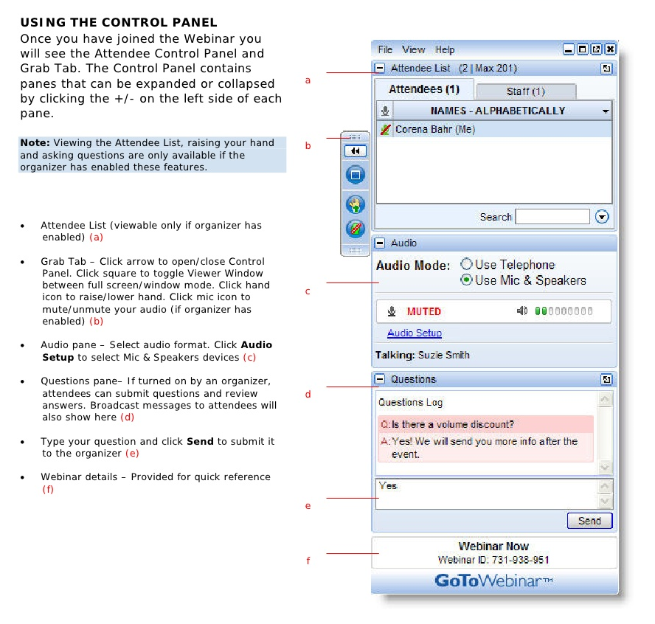
Webinar Housekeeping

Slide 6



2017 Training Roadmap
Webinars
http://www.xrmcoaches.com/webinars
KnowledgeBits
http://www.xrmcoaches.com/knowledgebits
Learning Plans
http://www.xrmcoaches.com/freestuff
More Goodies
Practice tests
On–Demand video training
Instructor–led training
Books

Slide 7
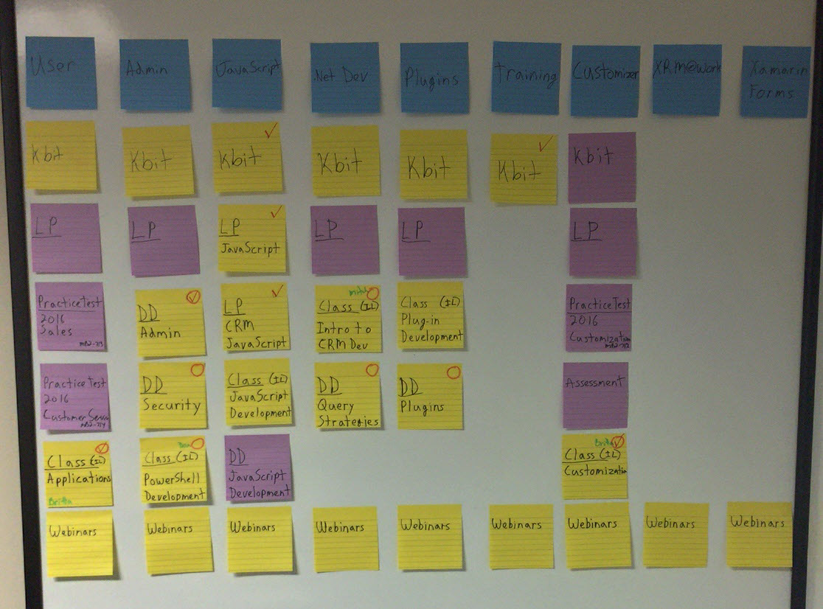
Roadmap

Slide 8
Agenda
A bit of background
Stages of a Dynamics 365 Developer’s Life
Mitch’s Dynamics 365 Developer Training Process

Slide 9
Overview

Slide 10
My Dynamics CRM Journey
Started with Dynamics CRM version 3.0
Installed so much Dynamics CRM that I lost count
Designed and implemented a lot of customizations
Wrote a ton of JavaScript and C#
Updated my skills with each new CRM release

Slide 11
I also…
Wrote over 50 blog articles a year
Developed free tools and customizations to enhance Dynamics CRM
Created commercial add–on products
Became an MCT to teach other developers what I had learned
Was awarded the Most Valuable Professional title for my efforts

Slide 12
Stages of a Dynamics 365 Developer’s Life

Slide 13
Stage 1: User
Knows and understands the product from a user’s prospective
Helps design business processes
Performs quality assurance procedures
Part of the change commitee

Slide 14
Stage 2: Power User
Develops custom processes
Adds business process flows
Imports/exports data
Performs system administration tasks
Power BI

Slide 15
Stage 3: Customizer
Creates new entities and fields
Modified forms, views, charts, etc.
Works with users to develop business requirements
Adds Business Rules

Slide 16
Stage 4: Client-Side Developer
Adds JavaScript functionality
Customizes the Ribbon and SiteMap

Slide 17
Stage 5: Citizen Developer
Creates processes using Microsoft Flow
Creates task-specific applications using Power Apps
Adds Business Rules
Adds Business Process Flows
Adds workflows

Slide 18
Stage 6: Platform Developer
Creates server-side components in .NET
Plugins
Custom workflow activities
Custom integration components

Slide 19
Mitch’s Dynamics 365 Developer Training Process

Slide 20
Step 1:
Know and Understand Dynamics 365

Slide 21
Rule #1
You can’t develop against a product that you do not know

Slide 22
Know and Understand
The user interface and navigation
The terminology
Customization points
Where to get help should you need it

Slide 23
Rule #2
Be aware of version differences and how they will impact your solutions

Slide 24
Step 2:
Know and Understand the Dynamics CRM SDK

Slide 25
Dynamics CRM SDK
Documentation
Tools
Sample code
Other resources

Slide 26
Developing Custom Solutions
Learn the extension model
Learn the difference between configuration, customization, and development
Explore all options and choose the one which best fits the requirements
Practice, practice, practice

Slide 27
Step 3:
Learn the Business

Slide 28
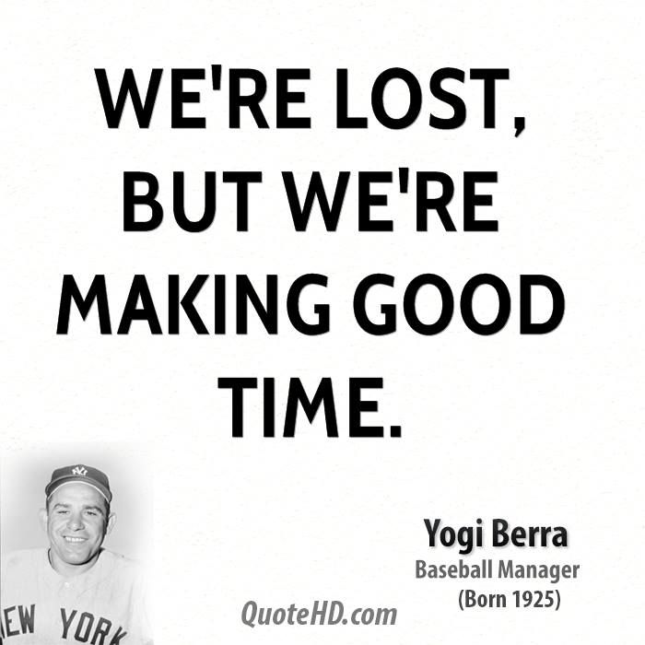
Learning the Business
Before you can automate the business, you have to know what parts can be automated

Slide 29
Rule #3
Technology does not solve process issues

Slide 30
Step 4:
Learn the Solutions Model

Slide 31
Solutions
Managed vs. Unmanaged
The solution update process
Deploying solutions from Development to Test to Production.

Slide 32
Step 5:
Understand the JavaScript Programming Model

Slide 33
JavaScript Object Model
Learn attribute methods
Learn control methods
Learn to control Tabs and Sections
Then learn everything else…

Slide 34
Step 6:
Learn how to modify the Dynamics CRM User Experience

Slide 35
User Experience Customization Points
SiteMap
Ribbon

Slide 36
Step 7:
Learn the .NET Programming Model

Slide 37
.NET Development
The necessary components
CRUD model
How to query for data
Deploying your code

Slide 38
Step 8:
Plugins

Slide 39
Plugins
Standard plugins
Custom workflow activities
The Plug–in Registration Tool
Working with the SandBox

Slide 40
Step 9:
Code-Less Development

Slide 41
Code-Less Development
Microsoft Flow
Power Apps

Slide 42
Review
Understand Dynamics CRM
Know the Dynamics CRM SDK
JavaScript programming model
User Experience modifications
Plugins and custom workflow activities
Learn the Solutions Model
Code-Less Development
.NET programming model
Learn the Business

Slide 43
Tools and Resources
XrmToolbox
CRM REST Builder
SnapShot! for Dynamics CRM/365
Ribbon Workbench
SiteMap Editor

Slide 44
Tools and Resources
CRM Email Workflow Utilities
CRM String Workflow Utilities
CRM Numeric Workflow Utilities
CRM DateTimeWorkflow Utilities
Dynamics CRM 2016 Workflow Tools

Slide 45
So…
There is a lot to know and understand
Invest in yourself
Put in the time and practice
Don’t be overwhelmed

Slide 46
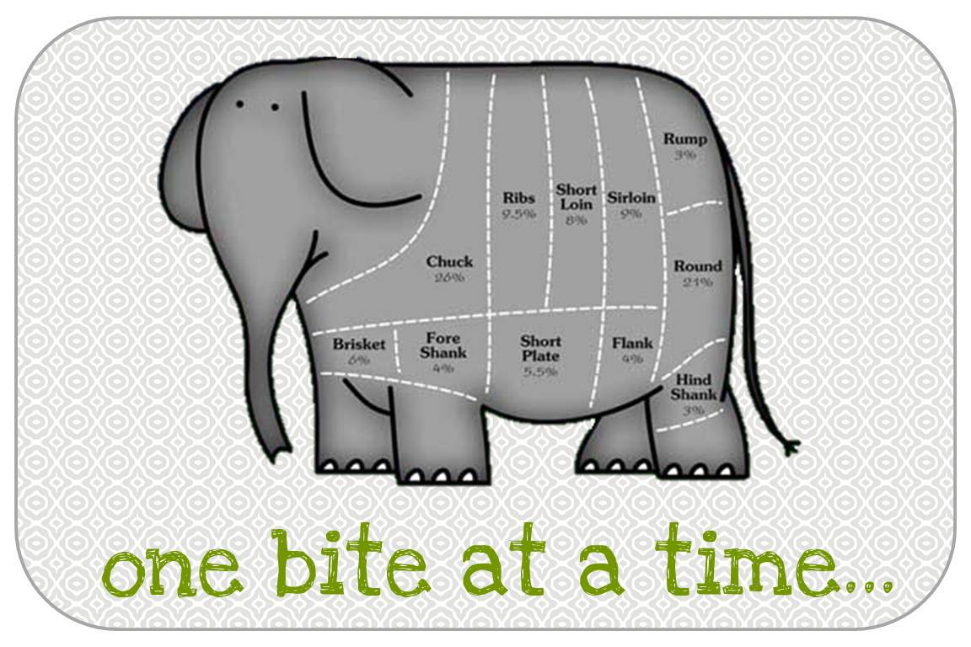
And Remember…

Slide 47
Questions?

Slide 48
Thank You

